Slide 1
Frames and Machines
Dr. Jacob Moore
Associate Professor of Engineering
Penn State Mont Alto

Slide 2
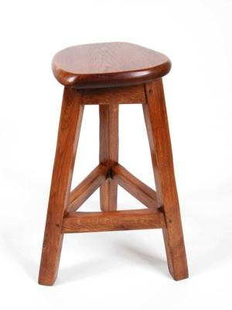
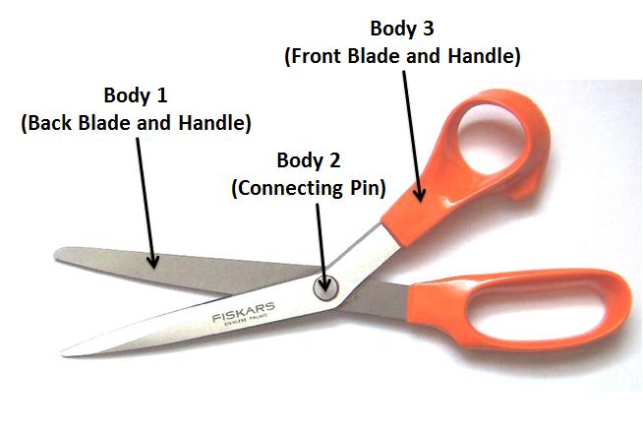
Frames and Machines
A frame or a machine is a structure that has at least one member that is not a two-force member.
A frame is rigid
A machine is not rigid
Because we can’t assume that each member is a two-force member we can’t use the method of joints or method of sections.
Though it is still useful to identify the two-force members that are present for analysis.

Slide 3
Non-Two Force Members and the Method of Joints
A member that is not a two-force member does not have a single unknown force along a known direction
F_{BD1Y}
F_{AB}
B
6 kN
F_{BD1X}
F_{BC}
F_{BD}
3 kN
3 kN
F_{BC}
F_{BD}
F_{BD2Y}
F_{AB}
F_{AC}
F_{AC}
F_{CD}
F_{CD}
F_{BD2X}
A
C
D
6 kN

Slide 4
Non-Two Force Members and the Method of Sections
A member that is not a two-force member that is “cut” will have two unknown forces and a moment where cut.
66.7 kN
60 kN
30 kN
F_{BDY}
M_{BD}
A
B
F_{BD}
F_{BDX}
F_{BE}
F_{CE}
C

Slide 5
Analysis of Frames and Machines
The analysis of Frames and Machines works on the following assumptions.
The structure you are analyzing is in static equilibrium. If it is independently rigid, then we can analyze the whole structure to find the external reaction forces.
Each component in the structure you are analyzing is also in static equilibrium and can be analyzed as a separate rigid body to find the forces acting on it.
Whenever two components are connected, there will be equal and opposite forces acting on each component at that connection point (in the form of a Newton’s Third Law pair).

Slide 6
Thanks for Watching
See other engineering mechanics videos and access the full tool at…

